Slide 1

Review of COVID-19 Models

Slide 2


Slide 3
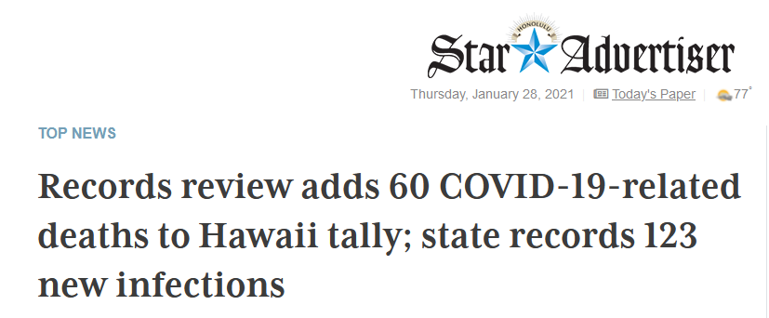
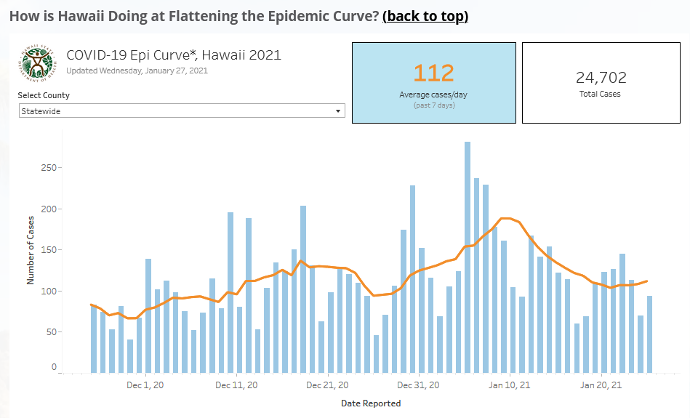
COVID-19 data is messy
https://www.staradvertiser.com/2021/01/25/breaking-news/hawaii-records-123-new-coronavirus-infections-bringing-statewide-total-to-25275/
Sunday
“Our close inspection of death certificates not only revealed 60 previously unreported deaths. It also uncovered flaws that led to delays in the current reporting system,” Char said in a statement.

Slide 4

What is a model?
A physical, mathematical, or otherwise logical representation of a system, entity, phenomenon, or process
DoD. 1998. "'DoD modeling and simulation (M&S) glossary," in DoD Manual 5000.59-M. Arlington, VA, USA: US Department of Defense. January. P2.13.22. Available at http://www.dtic.mil/whs/directives/corres/pdf/500059m.pdf

Slide 5
Why use COVID-19 models?
Forecast number of cases, hospitalizations, ICU beds, fatalities, etc.
Determine whether our healthcare systems will be overwhelmed (and if so when)
See impacts of interventions and policy measures

Slide 6
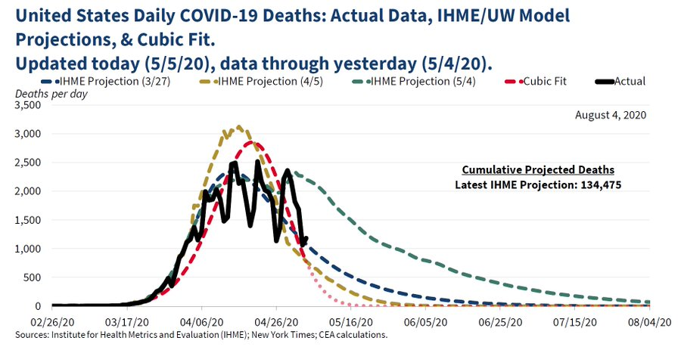
Mechanistic vs Statistical models
Mechanistic model - makes assumptions about how a system or process works
Statistical model - fits curves using existing data
S Susceptible
I
Infectious
R
Removed

Slide 7
Statistical Models
“fit curves using existing data”

Slide 8
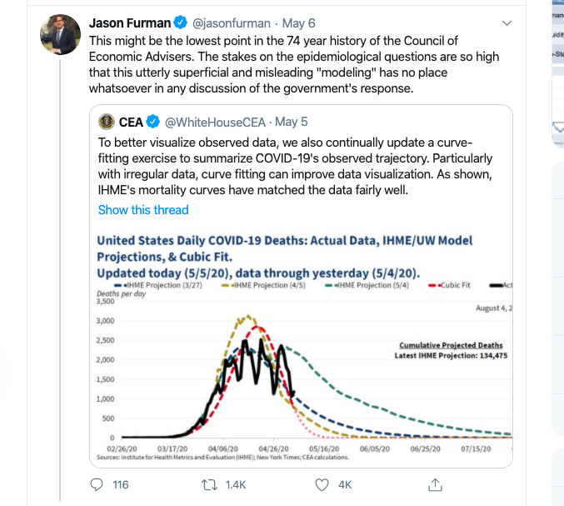
White House Council of Economic Advisers
https://twitter.com/WhiteHouseCEA/status/1257680258364555264

Slide 9
White House Council of Economic Advisers
https://twitter.com/jasonfurman/status/1257707830787915777?lang=en

Slide 10
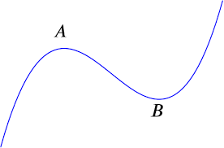
White House Council of Economic Advisers
“Cubic fit” y=ax³+bx²+cx+d
https://twitter.com/WhiteHouseCEA/status/1257680258364555264

Slide 11
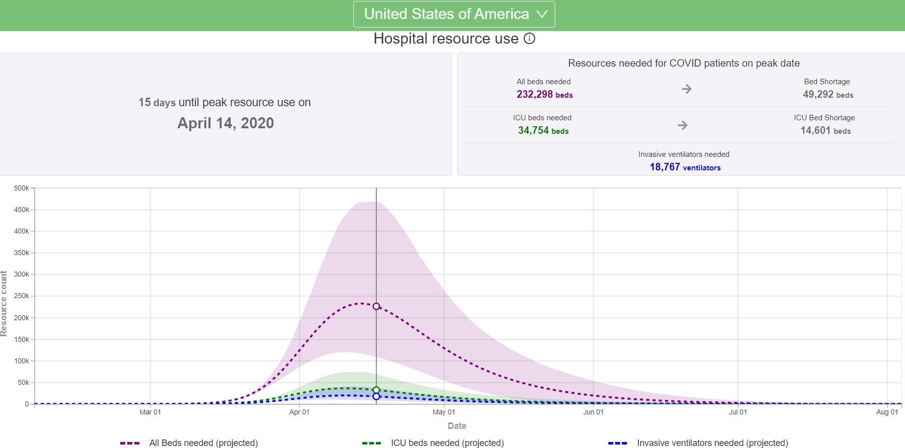
The IHME Model
The Institute for Health Metrics (IHME) is an independent global health research center at the University of Washington
The IHME model was the main model used in early days of COVID-19
Has projections by state and country for hospitalizations, ICU bed usage, and fatalities
https://covid19.healthdata.org/

Slide 12
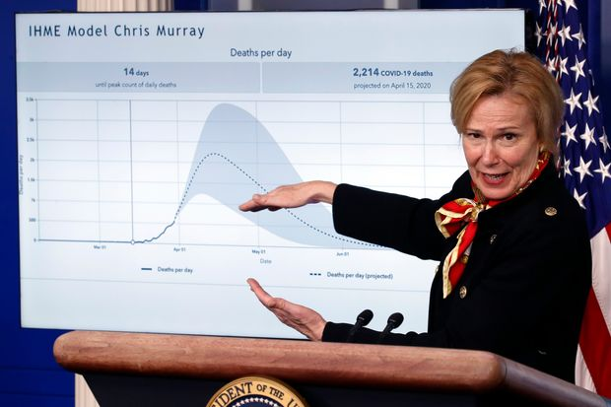
The IHME Model
Statistical model - early on used the existing death data from China and Italy to predict what would happen in the United States and elsewhere.
Criticisms about the IHME model
Was overly optimistic
Continually updated with significant changes to numbers
The true number of next day deaths were outside of the 95% prediction intervals 70 percent of the time¹
1.
¹ https://arxiv.org/abs/2004.04734

Slide 13
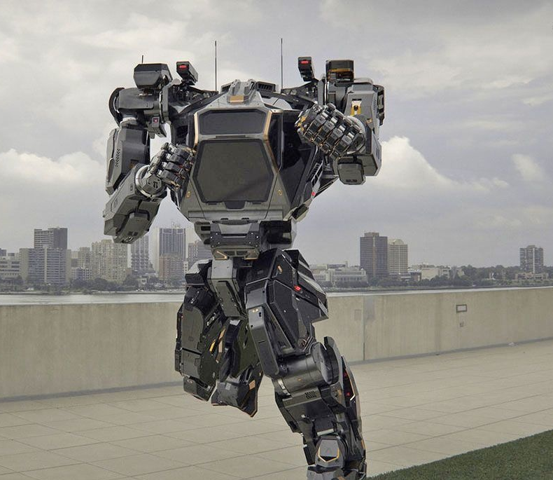
Mechanistic Models
“make assumptions about how a system or process works”
https://www.engadget.com/2017-01-01-korea-mech-robot-first-steps.html

Slide 14
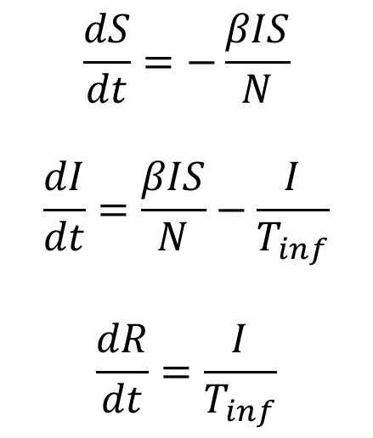
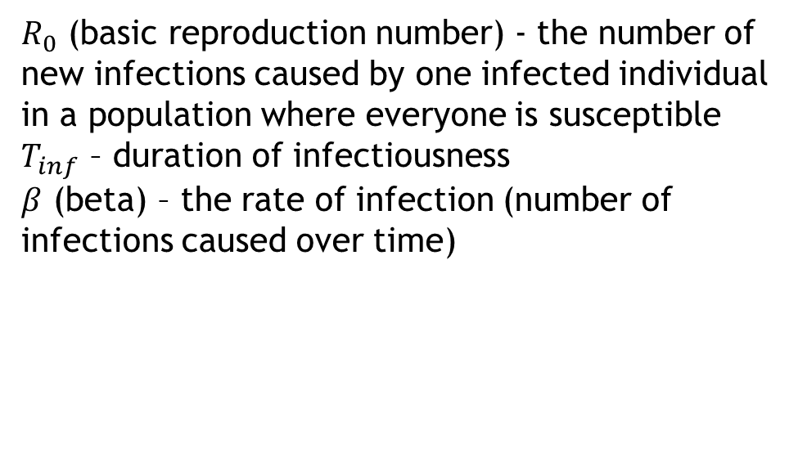
What are SIR models?
S Susceptible
I
Infectious
R
Removed
$$\frac{dS}{dt}=−\frac{βIS}{N}$$
$$\frac{dI}{dt}=\frac{βIS}{N}−\frac{I}{T_{inf}}$$
$$\frac{dR}{dt}=\frac{I}{T_{inf}}$$
$R_{0}$ (basic reproduction number) - the number of new infections caused by one infected individual in a population where everyone is susceptible
$T_{inf}$ – duration of infectiousness
$β$ (beta) – the rate of infection (number of infections caused over time)

Slide 15
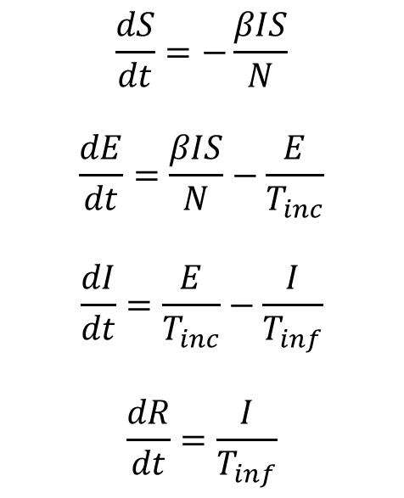
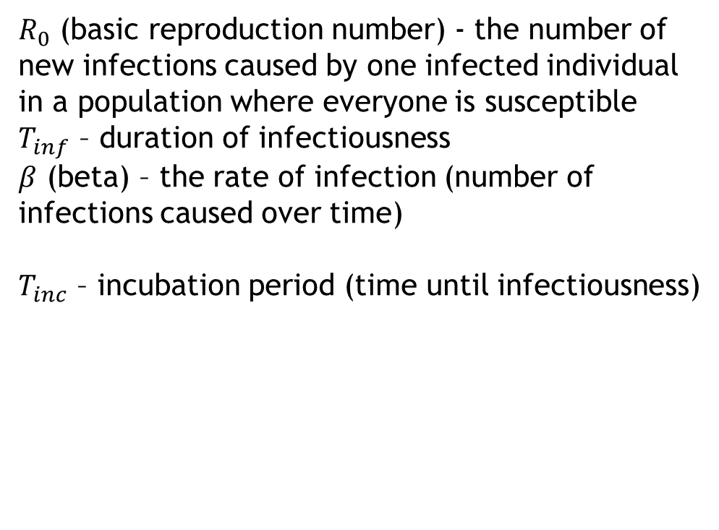
What are SEIR models?
S Susceptible
E
Exposed
I
Infectious
R
Removed
$$\frac{dS}{dt}=−\frac{βIS}{N}$$
$$\frac{dE}{dt}=\frac{βIS}{N}−\frac{E}{T_{inc}}$$
$$\frac{dI}{dt}=\frac{E}{T_{inc}}−\frac{I}{T_{inf}}$$
$$\frac{dR}{dt}=\frac{I}{T_{inf}}$$
$R_{0}$ (basic reproduction number) - the number of new infections caused by one infected individual in a population where everyone is susceptible
$T_{inf}$ – duration of infectiousness
$β$ (beta) – the rate of infection (number of infections caused over time)
$T_{inc}$ – incubation period (time until infectiousness)

Slide 16
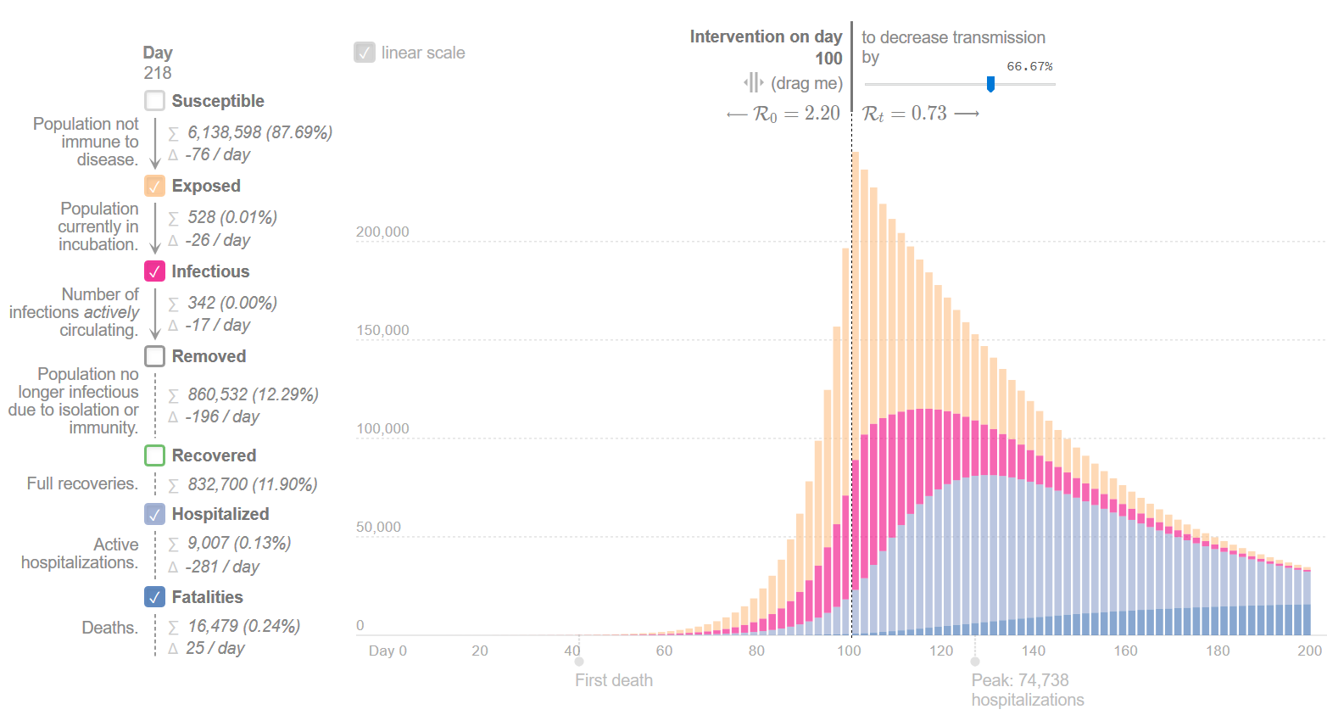
Epidemic Calculator
https://gabgoh.github.io/COVID/index.html

Slide 17
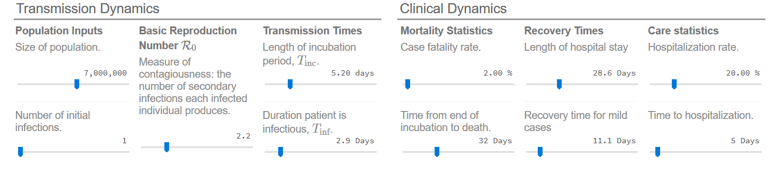
Epidemic Calculator
https://gabgoh.github.io/COVID/index.html

Slide 18
Epidemic Calculator
Susceptible
Exposed
Infectious
Severely Hospitalized
Fatally Hospitalized
Recovered
Fatal
Mildly Symptomatic
Recovered

Slide 19
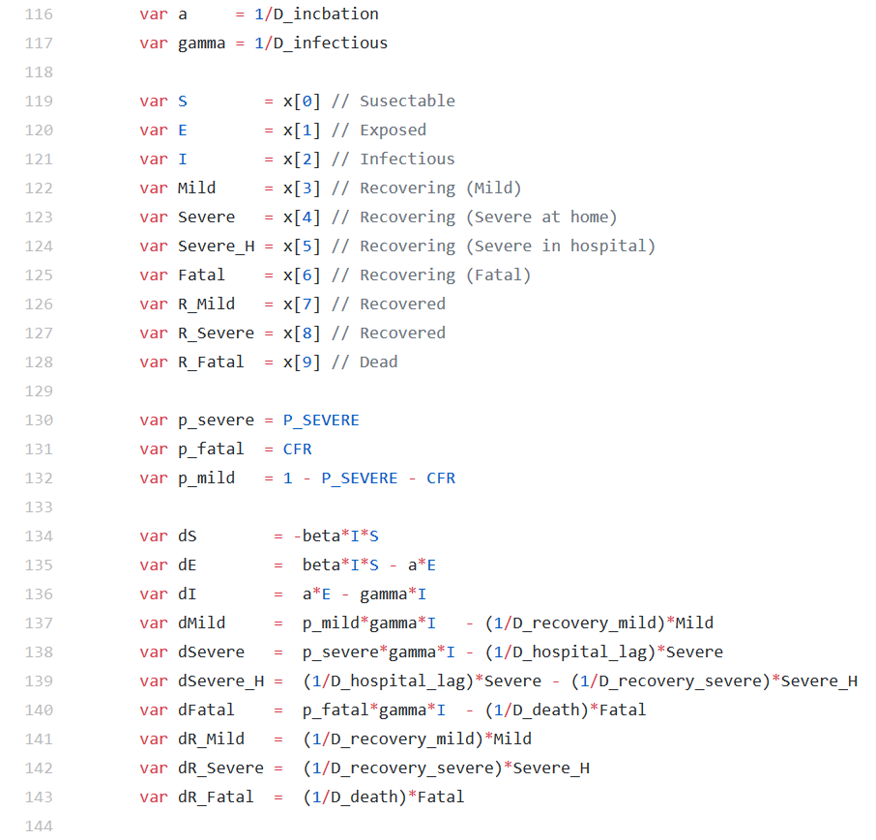
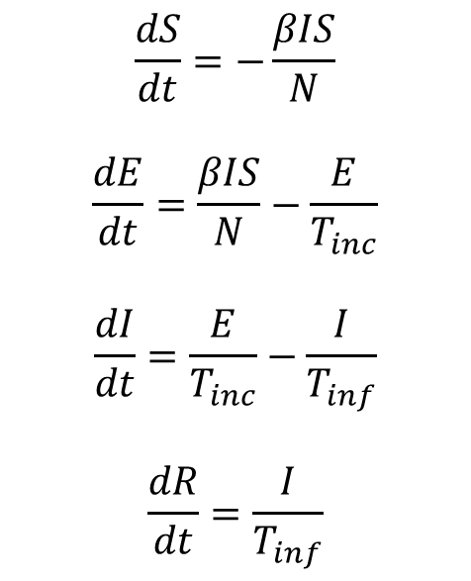
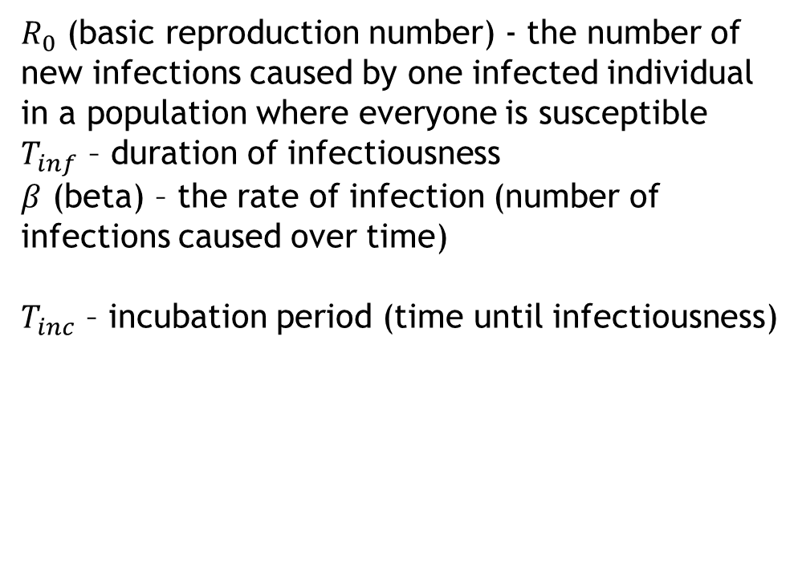
Epidemic Calculator
$$\frac{dS}{dt}=−\frac{βIS}{N}$$
$$\frac{dE}{dt}=\frac{βIS}{N}−\frac{E}{T_{inc}}$$
$$\frac{dI}{dt}=\frac{E}{T_{inc}}−\frac{I}{T_{inf}}$$
$$\frac{dR}{dt}=\frac{I}{T_{inf}}$$
$R_{0}$ (basic reproduction number) - the number of new infections caused by one infected individual in a population where everyone is susceptible
$T_{inf}$ – duration of infectiousness
$β$ (beta) – the rate of infection (number of infections caused over time)
$T_{inc}$ – incubation period (time until infectiousness)
https://github.com/gabgoh/epcalc/blob/master/src/App.svelte

Slide 20
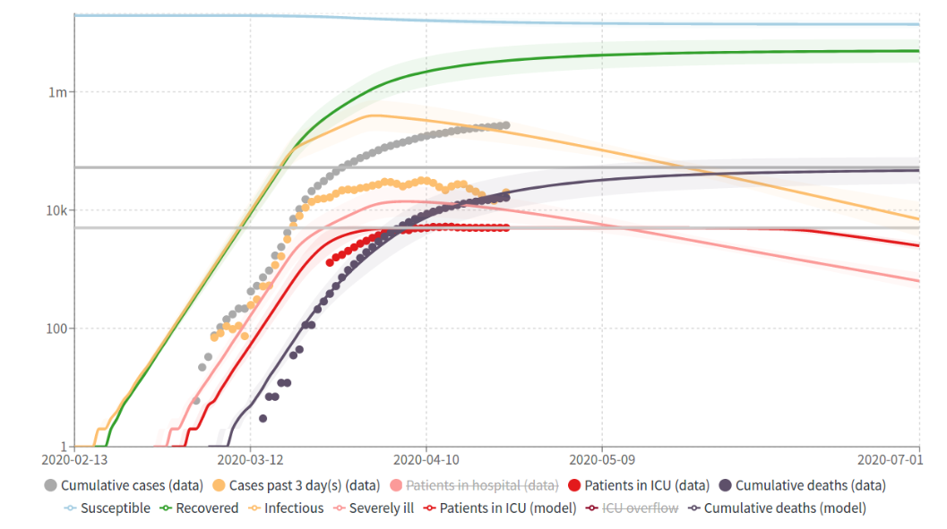
COVID-19 Scenarios Model (University of Basel)
https://covid19-scenarios.org/

Slide 21
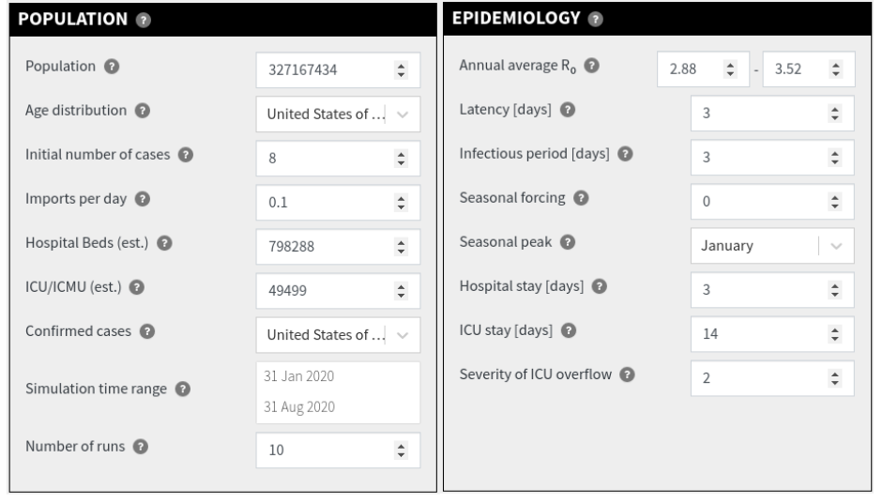
COVID-19 Scenarios Model (University of Basel)
https://covid19-scenarios.org/

Slide 22
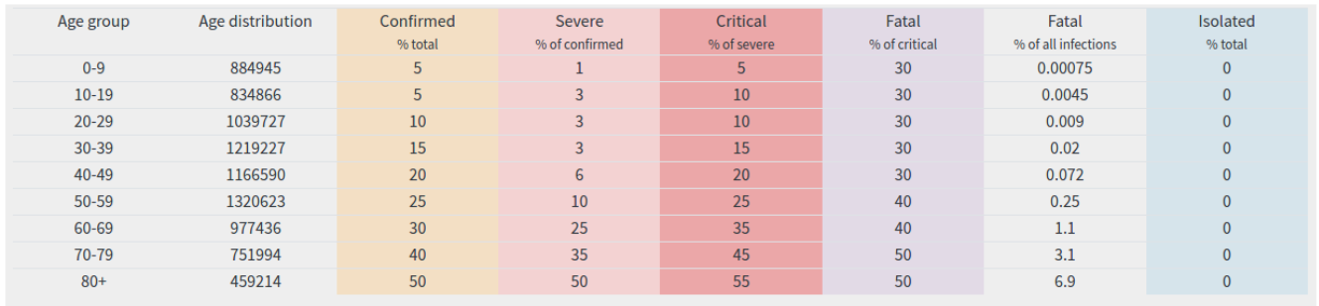
COVID-19 Scenarios Model (University of Basel)
https://covid19-scenarios.org/

Slide 23
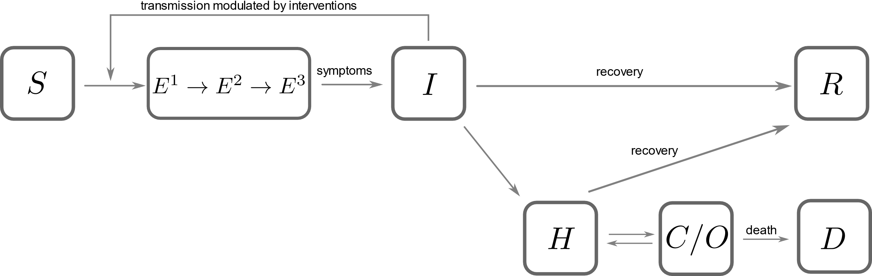
COVID-19 Scenarios Model (University of Basel)
https://covid19-scenarios.org/

Slide 24
COVID-19 Scenarios Model (University of Basel)
https://covid19-scenarios.org/

Slide 25
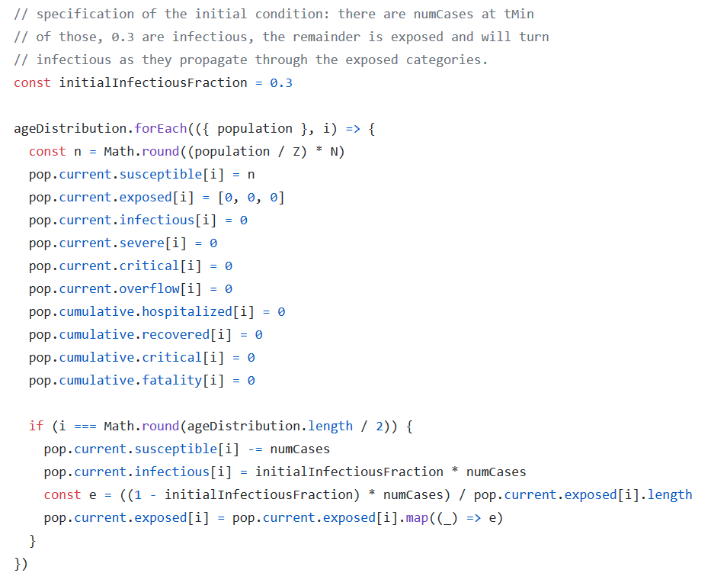
COVID-19 Scenarios Model (University of Basel)
How does the model implement initial number of cases?
Looking at the source code ->
https://github.com/neherlab/covid19_scenarios/blob/master/src/algorithms/initialize.ts

Slide 26
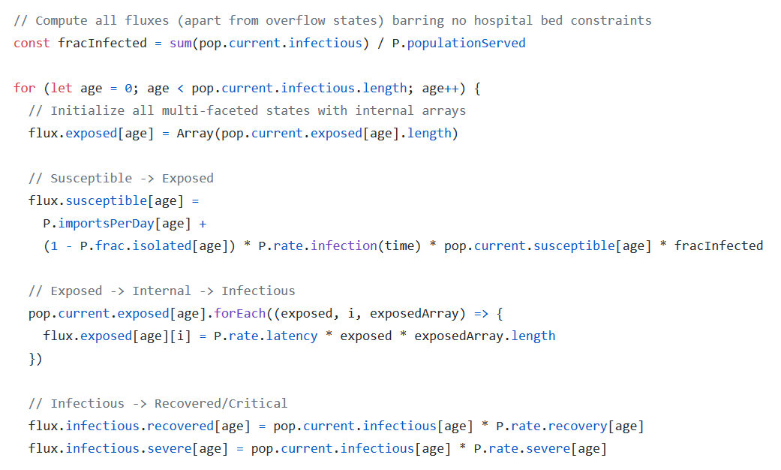
COVID-19 Scenarios Model (University of Basel)
How does the model implement imported cases per day?
Looking at the source code ->
https://github.com/neherlab/covid19_scenarios/blob/master/src/algorithms/model.ts

Slide 27
Thank you! Any questions?

